Slide 1
Python in practice

Slide 2
Python in practice
The kind of programming we've seen so far in python isn't how typical data programming in python goes.
Instead, we tend to rely a lot of modules that add methods to our complex data science objects. + Most python objects are class objects that come with a variety of convenient methods associated with them.
If you're working in a good coding environment, then it should have some method autocompletion for your objects, which helps prevent typos and can speed up work.

Slide 3
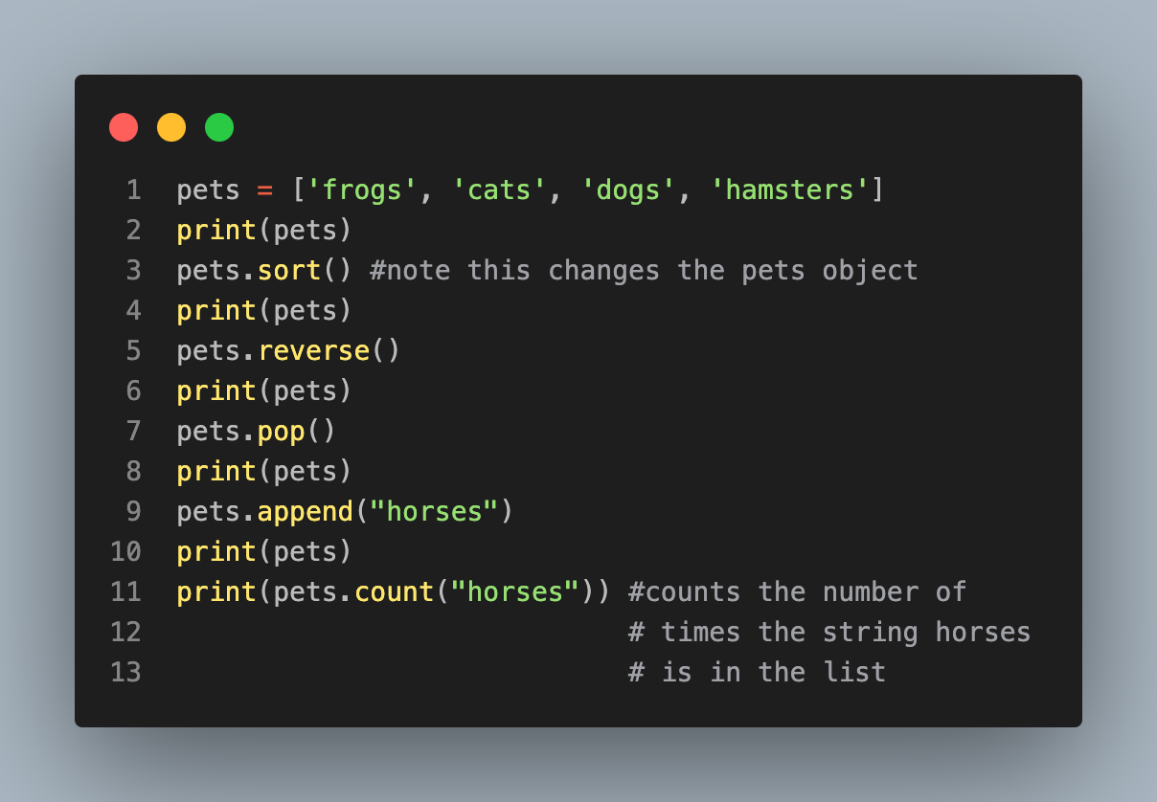
Example
['frogs', 'cats', 'dogs', 'hamsters’]
['cats', 'dogs', 'frogs', 'hamsters’]
['hamsters', 'frogs', 'dogs', 'cats’]
['hamsters', 'frogs', 'dogs’]
['hamsters', 'frogs', 'dogs', 'horses’]
1

Slide 4
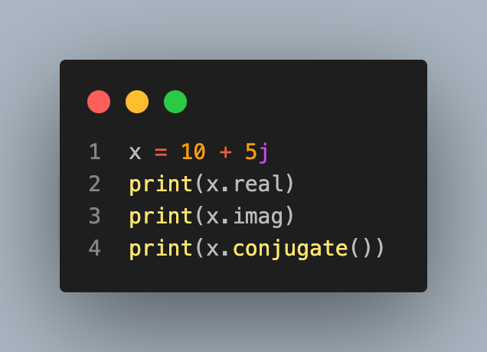
Making our own object with methods
Existing method
10.0
5.0
(10-5j)
Let's create our own version of a complex number, adapted from here.

Slide 5
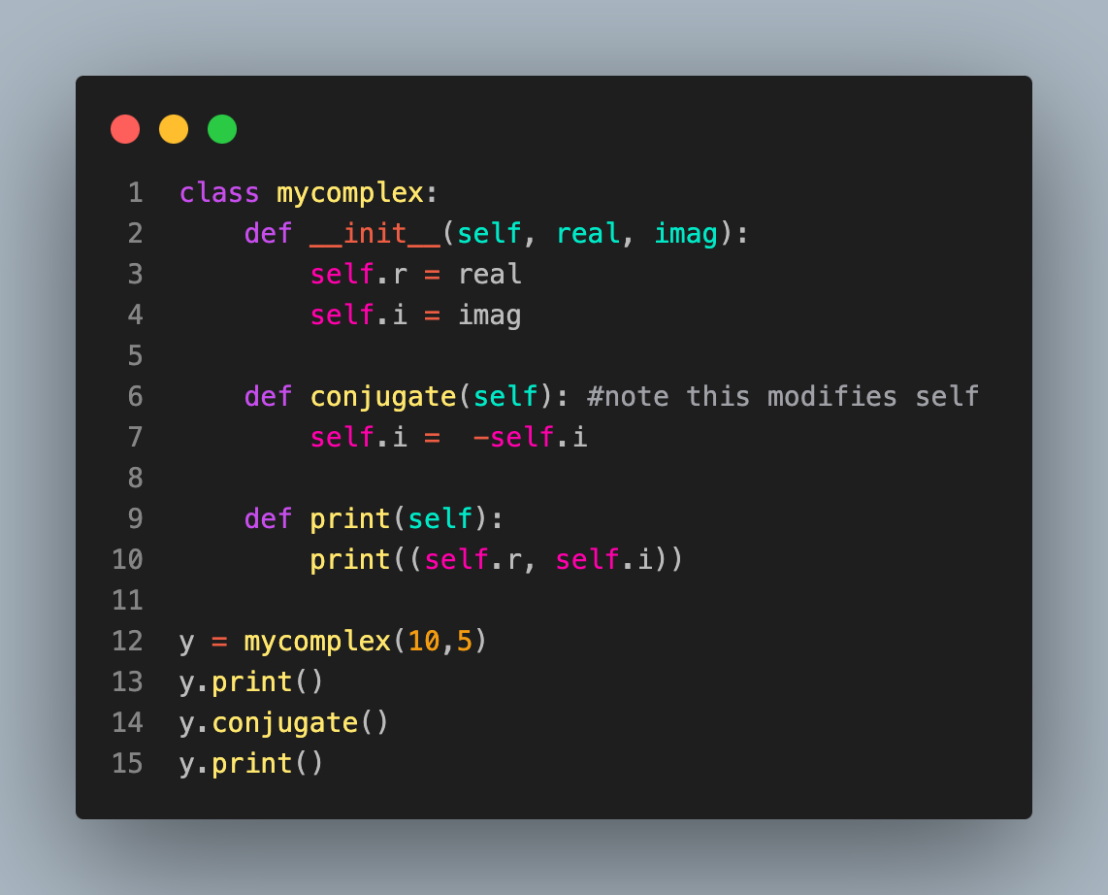
Custom Object
(10, 5)
(10, -5)

Slide 6
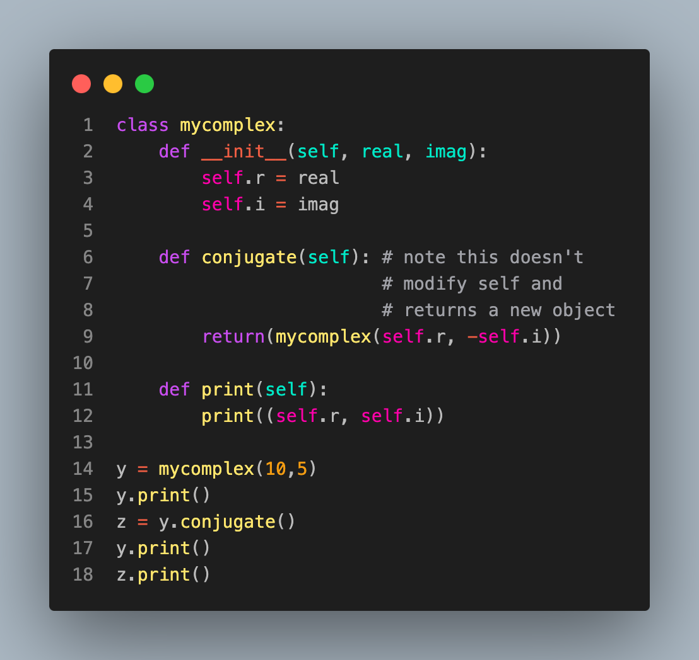
A version that doesn't modify the object when we conjugate
(10, 5)
(10, 5)
(10, -5)

